Slide 1
How can solar energy
make a difference?

Slide 2
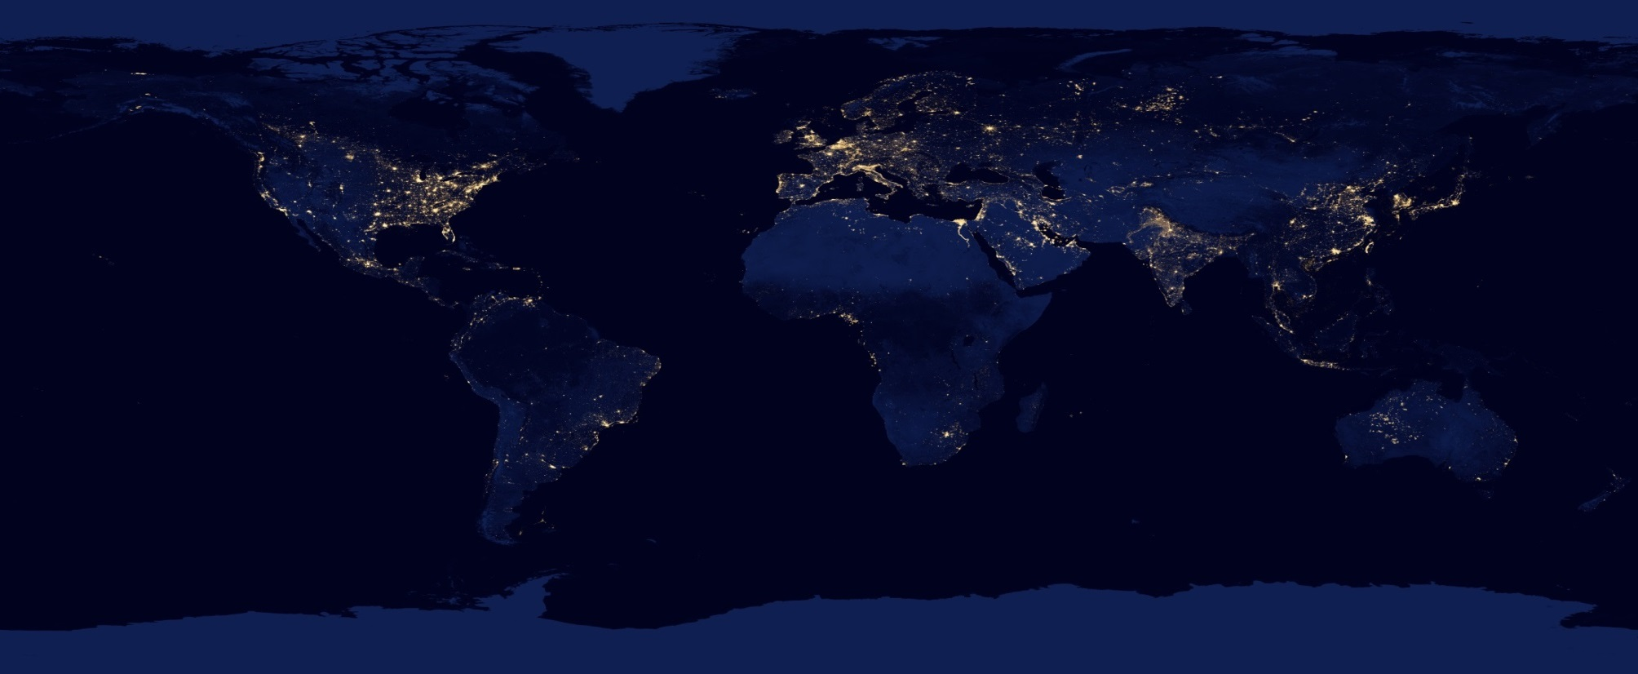
What does this image show?
Notes:
SAKS4L1.1
Data for this map was acquired over 9 days in April 2012 and 13 days in October 2012. It took satellite 312 orbits and 2.5 terabytes of data to get a clear shot of every parcel of Earth’s land surface and islands. http://earthobservatory.nasa.gov/Features/NightLights/page3.php

Slide 3
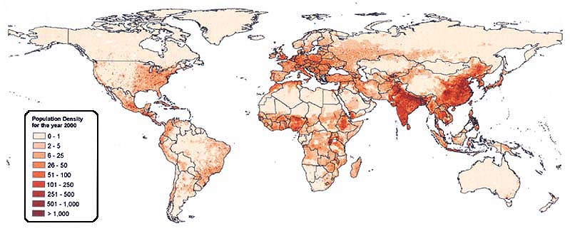
Population density in 2000
Source: Center for International Earth Science Information Network (CIESIN), Columbia University and Centro Internacional de Agricultura Tropical (CIAT)
Notes:
SAKS4L1.2
This map is taken from the UN Food and Agriculture Organisation website.
http://www.fao.org/docrep/009/a0310e/A0310E07.jpg

Slide 4
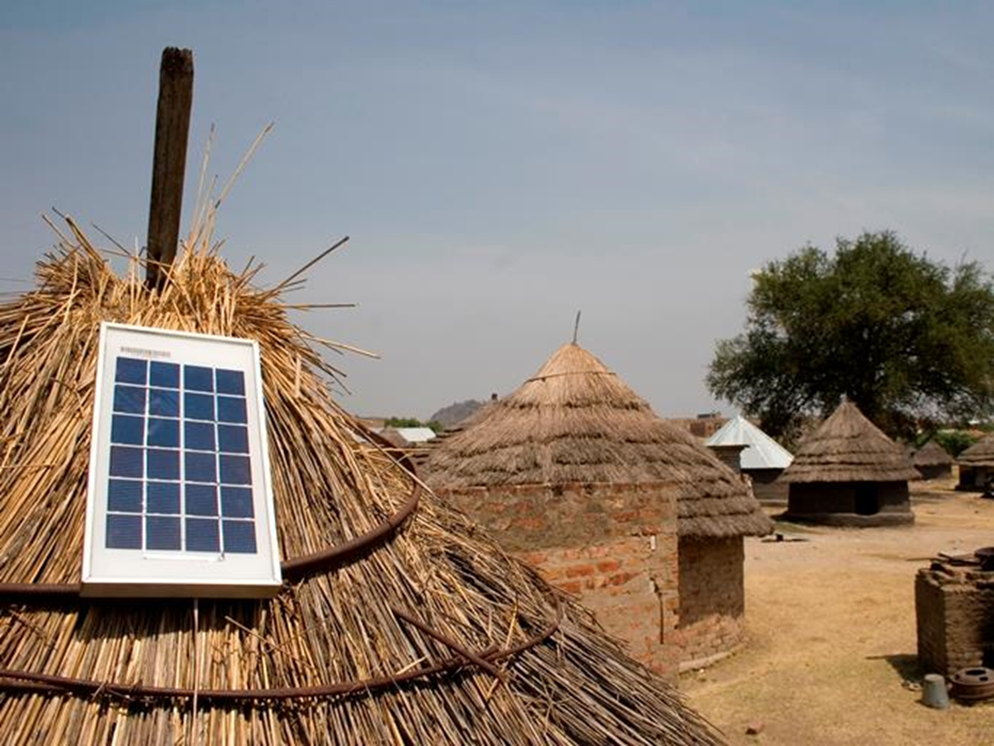
In some areas there is no mains electricity.
The Sun sets at 6pm and doesn’t rise until 6 am the next day.

Slide 5
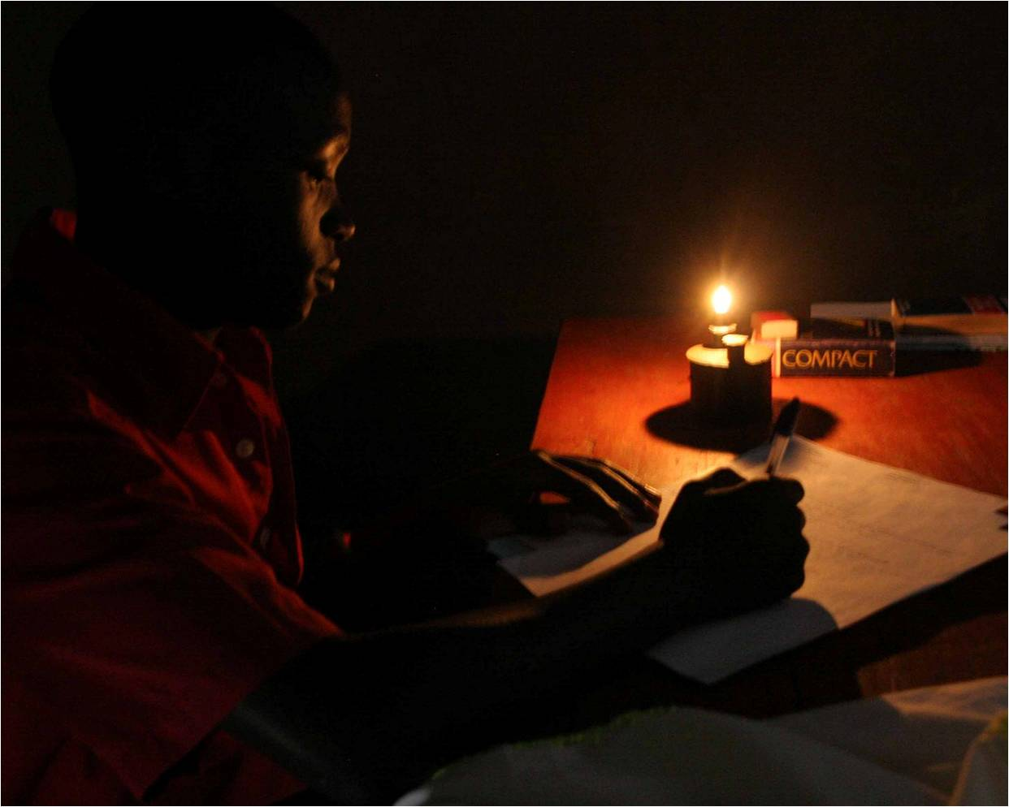
The kerosene lamp
Notes:
< SAKS4L1.3> This is Douglas, he lives in Tanzania and is using a kerosene lamp to do his homework.
Watch this 2 minute video from SolarAid demonstrating what it’s like for children using kerosene in the dark: http://bit.ly/OVZ5tM

Slide 6
What happens when kerosene burns?
Kerosene is also called paraffin.
It is a mixture of hydrocarbons produced from crude oil.
What are the combustion products when hydrocarbons burn?
Two hand made kerosene lamps

Slide 7
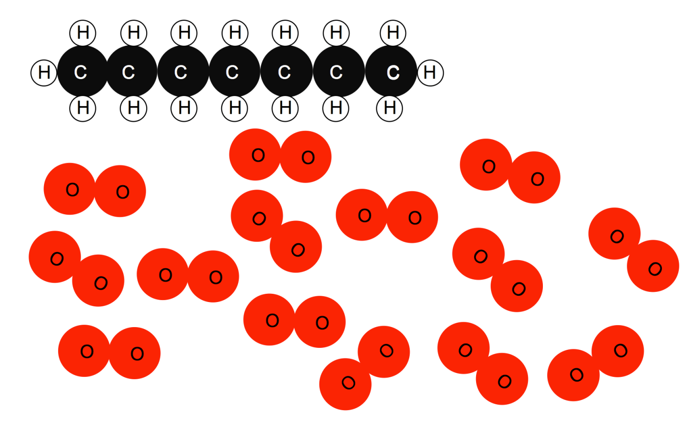
How much oxygen is needed for complete combustion of heptane?
heptane C₇H₁₆
oxygen O₂
Notes:
Drawn by UYSEG

Slide 8
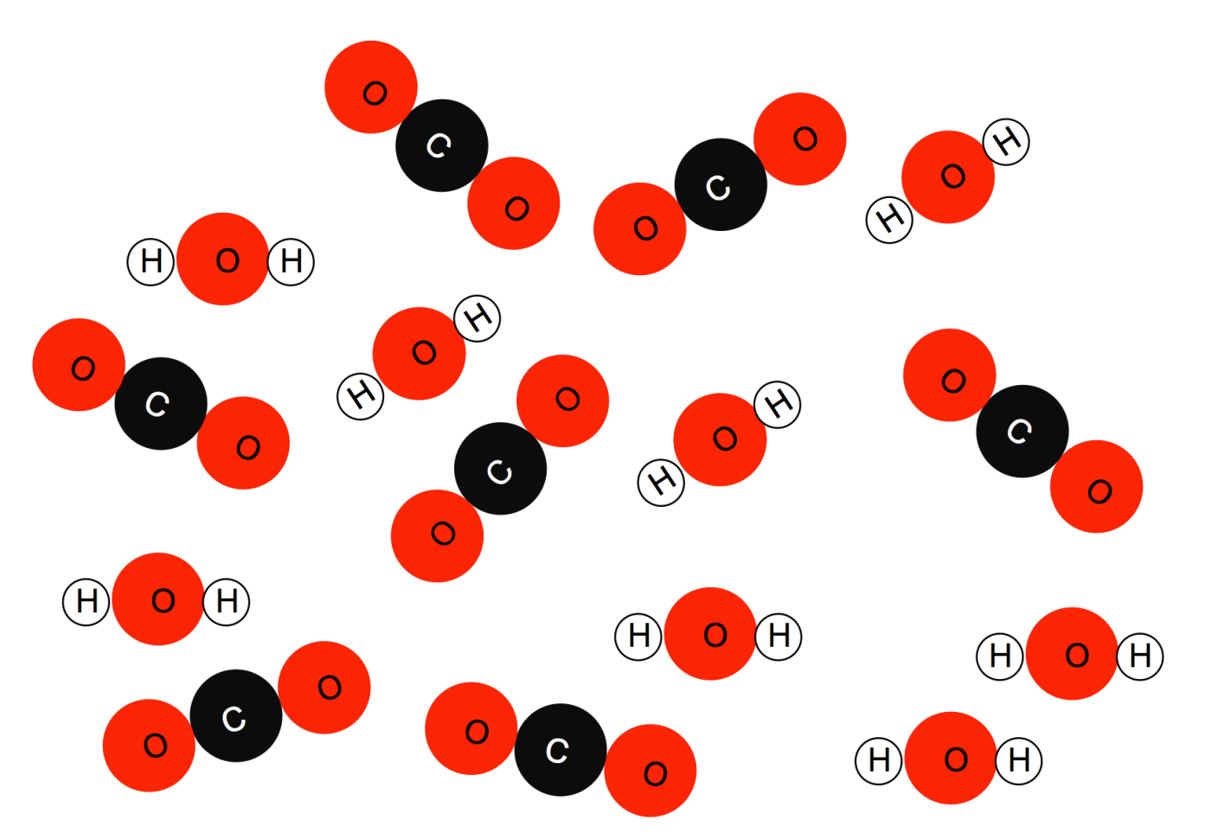
C₇H₁₆ + 11O₂ 7CO₂ + 8H₂O
Notes:
Drawn by UYSEG

Slide 9
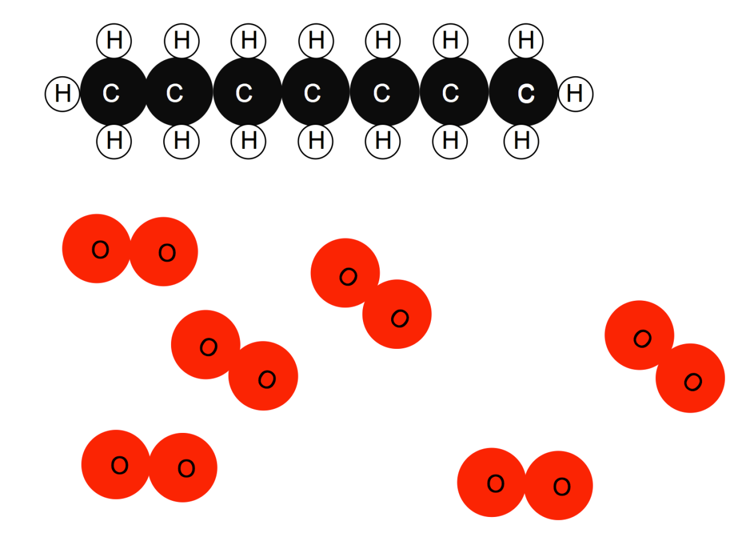
What happens if there is not enough oxygen?
heptane C₇H₁₆
oxygen O₂
Notes:
Drawn by UYSEG

Slide 10
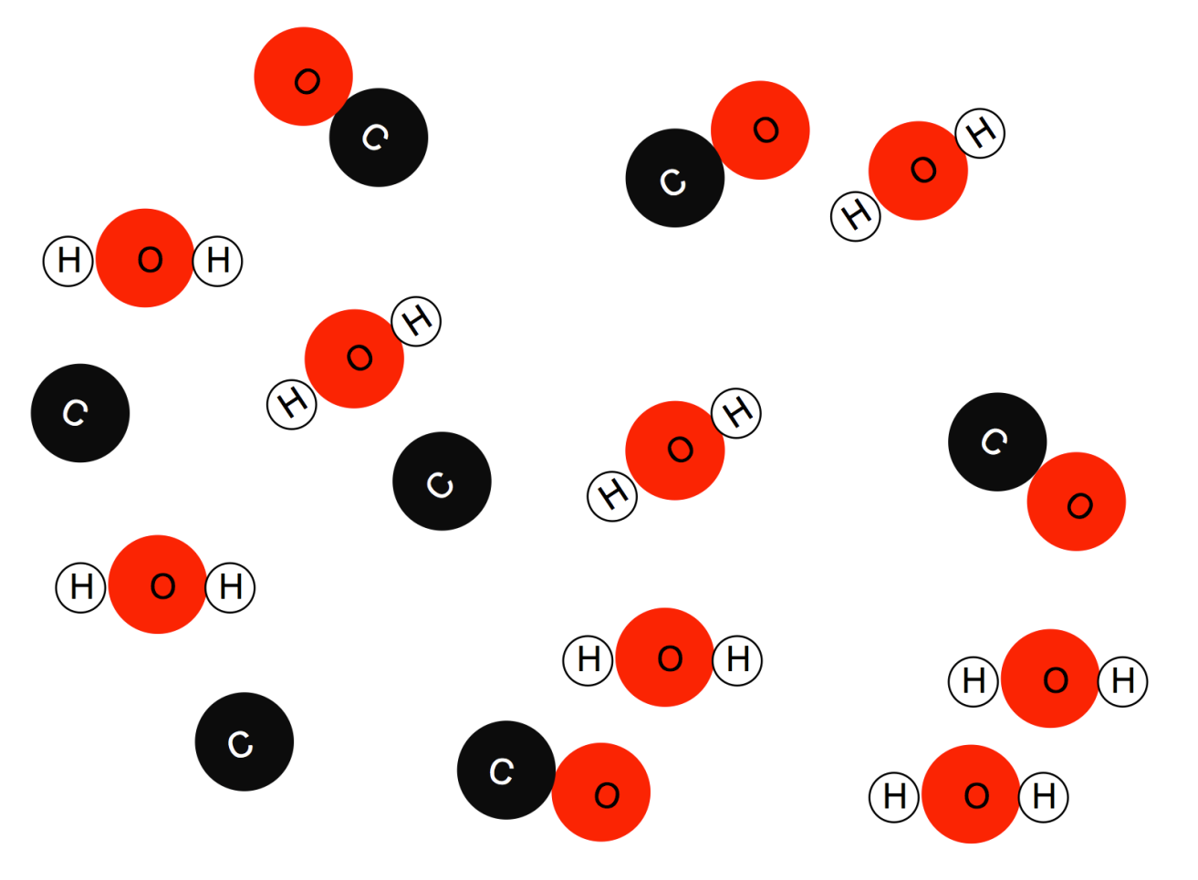
C₇H₁₆ + 6O₂ 8H₂O + 4CO + 3C
Notes:
Drawn by UYSEG

Slide 11
What are the risks of using kerosene lamps to light these homes?

Slide 12
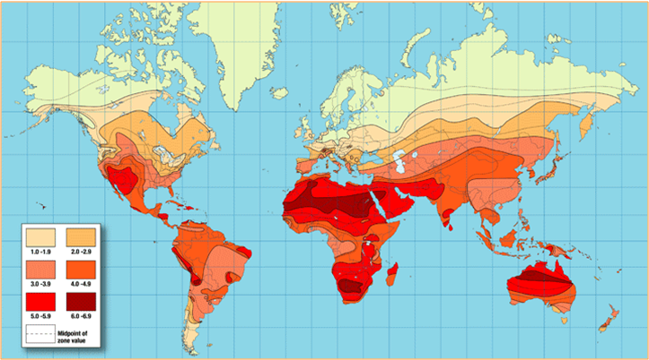
Irradiance map of the world
Notes:
Compare the amount of solar irradiation Africa received compared to the UK.

Slide 13
Notes:
A small solar panel like this charges a battery that powers a solar light when it gets dark (just like we charge our batteries for our mobile phones)
Energy transfer from the Sun by electromagnetic waves, stored by a battery and later transferred by electric current.

Slide 14
Education
Notes:
How would it help children’s education?
Guess what time it is here? 5am in the morning! This is the same boy from the picture with a kerosene lamp earlier. His name is Douglas, now he can study at school in the morning and evening. – he will do better in his exams as a result and hopes to continue studying.
And not only does it mean students can study longer, but teachers can prepare lessons and mark books before sunrise or after sunset.

Slide 15
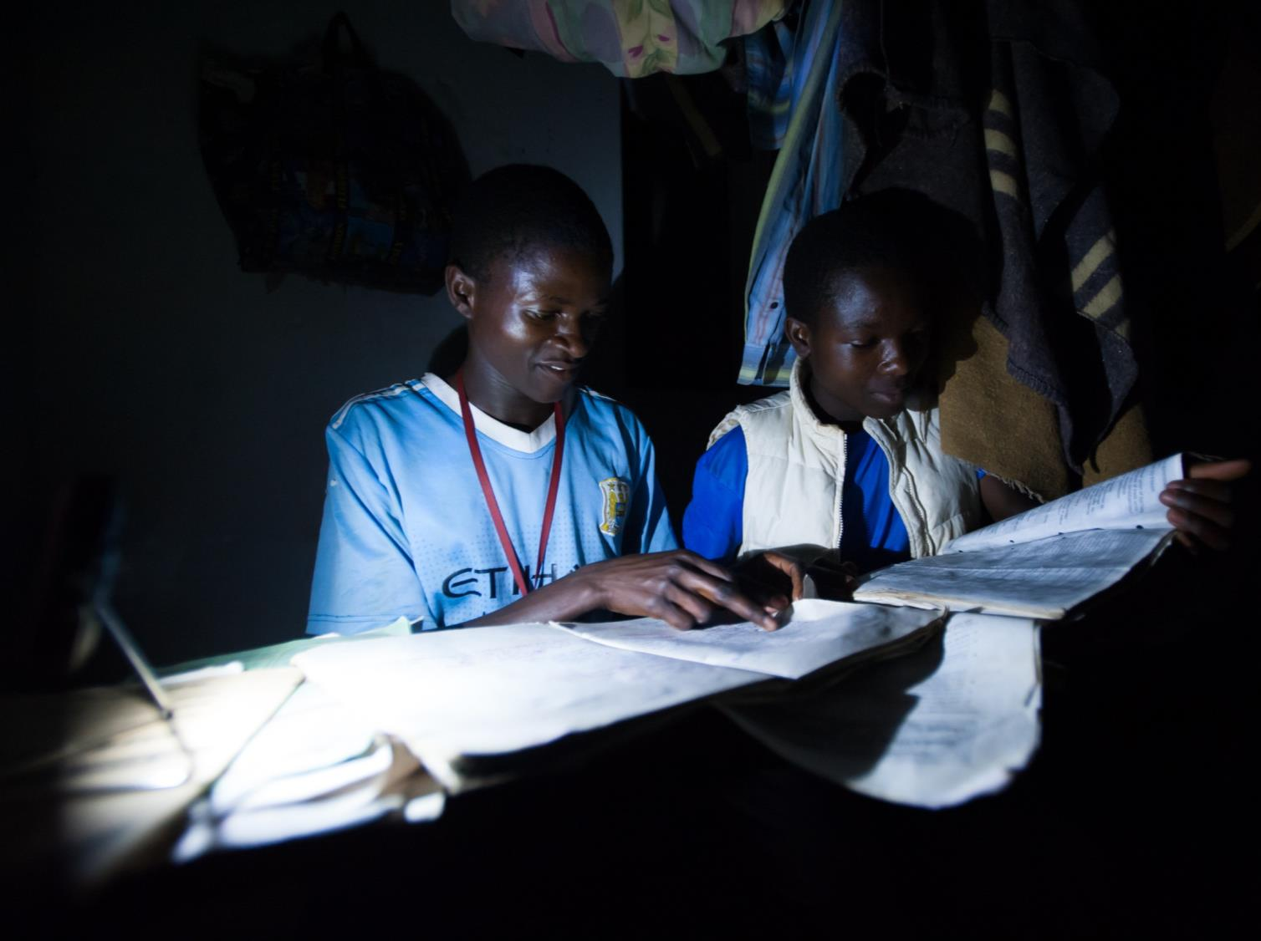
Education & Health
SolarAid research shows that students study an hour more, per night, on average, and are more motivated to study without eye strain or smoke.
Notes:
Introducing SolarAid.
These boys go to Maguya School in a place called Sakala in Zambia. See the small light in the corner – this is a solar powered light that a charity called SolarAid have been getting to schools in Africa. Electricity is created by a small solar panel so that students can have light at night. This means they are able to study in the evening or morning so that they are prepared to sit exams.

Slide 16
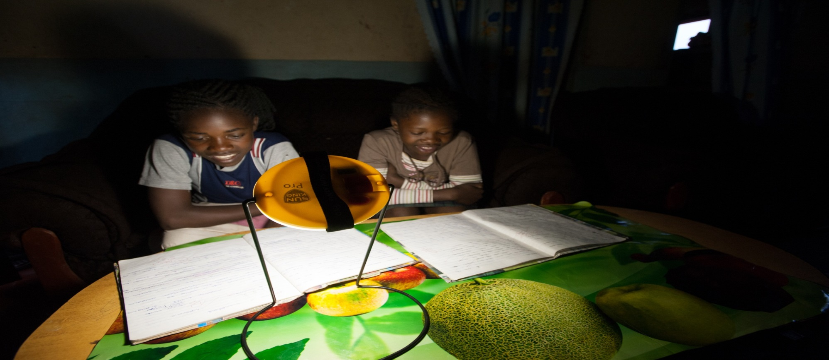
Health
Using a kerosene lamp for a year is estimated to be similar to inhaling the black carbon from smoking 298 cigarettes.
One lamp is estimated to emit a tonne of carbon over five years.
Notes:
How will it help their health?
No more black smoke from candles or kerosene lamps filling peoples lungs and making them cough or causing eye infections. Spending time with burning kerosene lamps contributes to indoor air pollution – and that does the same damage to your lungs as smoking cigarettes.
Solar energy is clean - enabling people to live healthier, longer and happier lives.

Slide 17
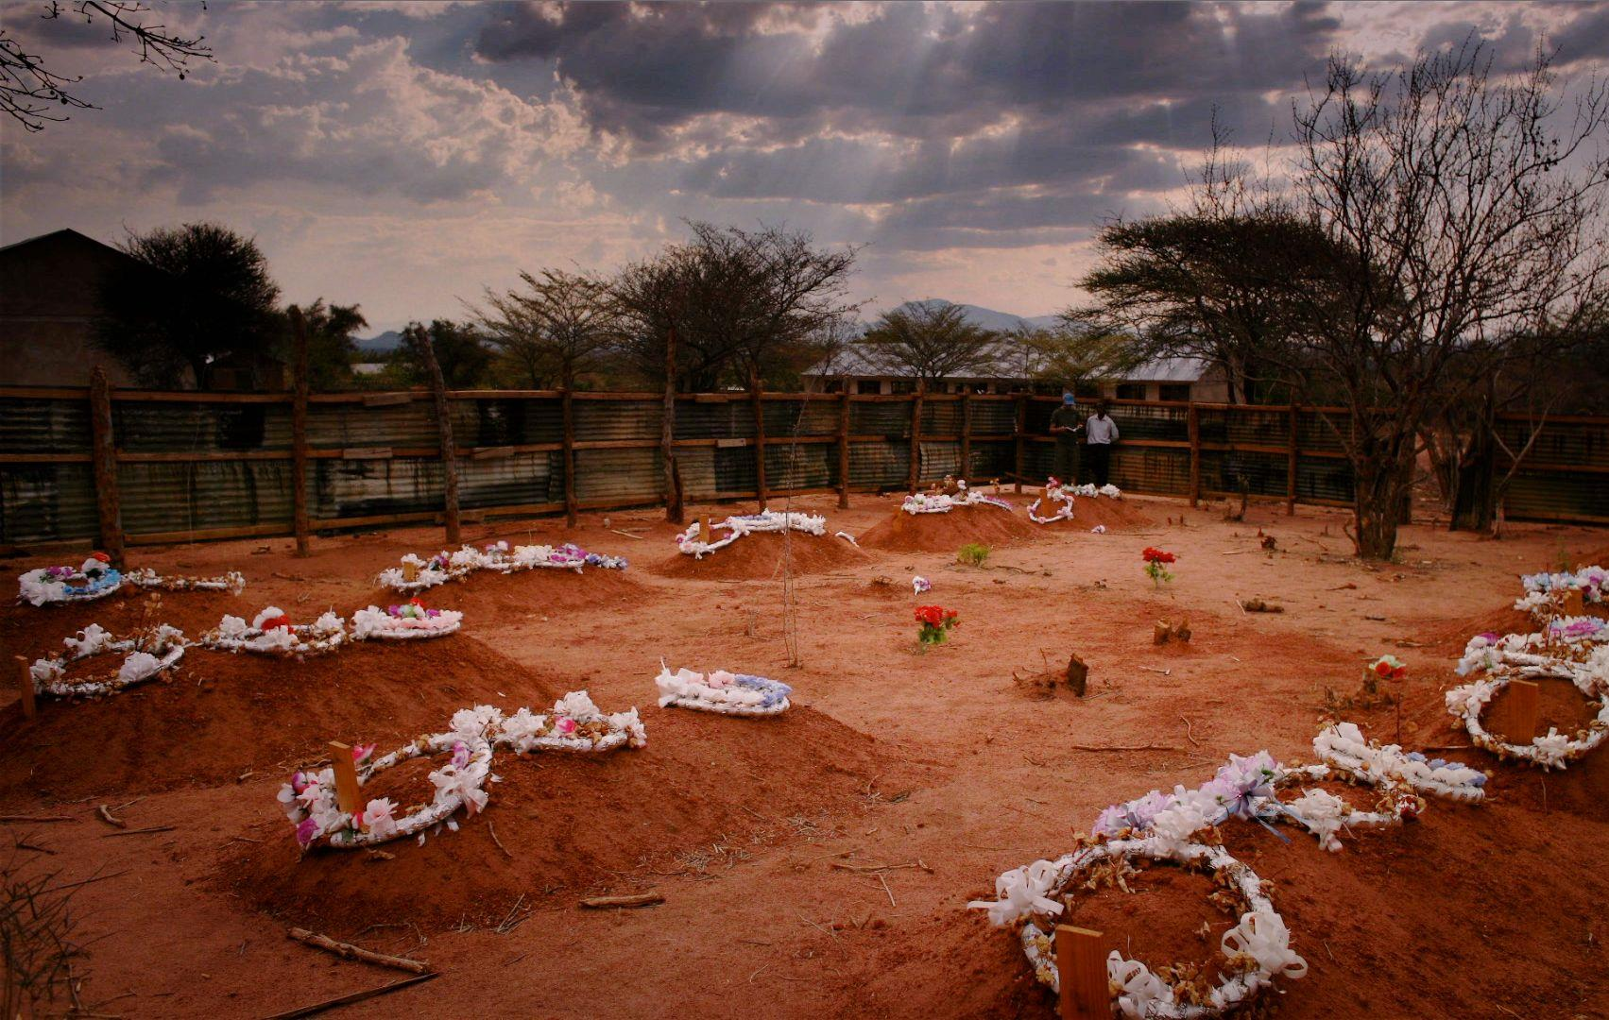
Safety
There used to be a school dormitory here – it burnt down after a fire was started by a kerosene lamp. The children who died have been buried in graves here.
Notes:
Why might it be safer?
There used to be a school dormitory here – it burnt down after a fire was started by a kerosene lamp. The children who died have been buried in graves here.
Solar energy takes away this risk.

Slide 18
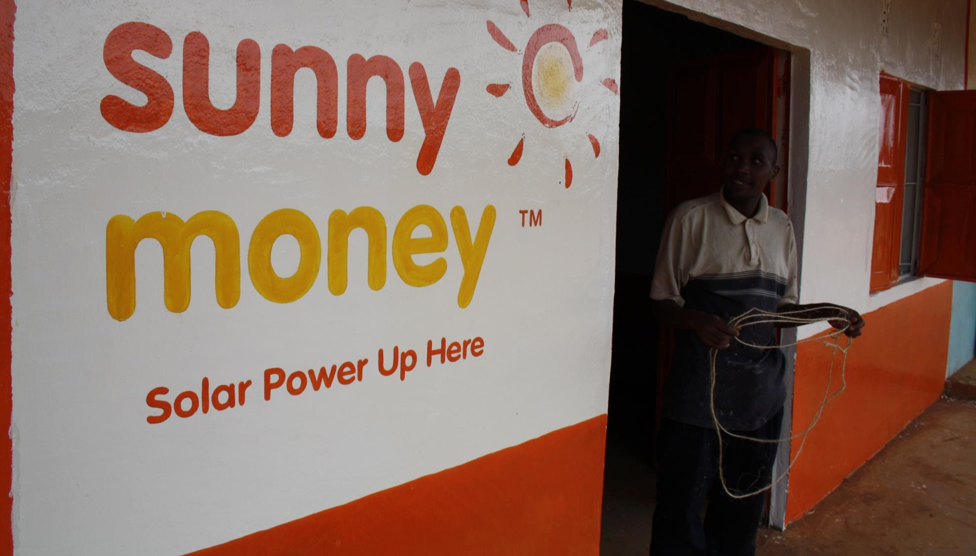
Wealth
Financial
Around 15% of a family's income is spent on lighting: kerosene, candles or batteries for torches.
The money saved from switching to solar energy and not buying kerosene is spent on better food, school fees and business development or farming inputs.
Notes:
When families get solar installed they no-longer have to purchase expensive kerosene and can save money to spend on more worthwhile things – like books and better food.

Slide 19
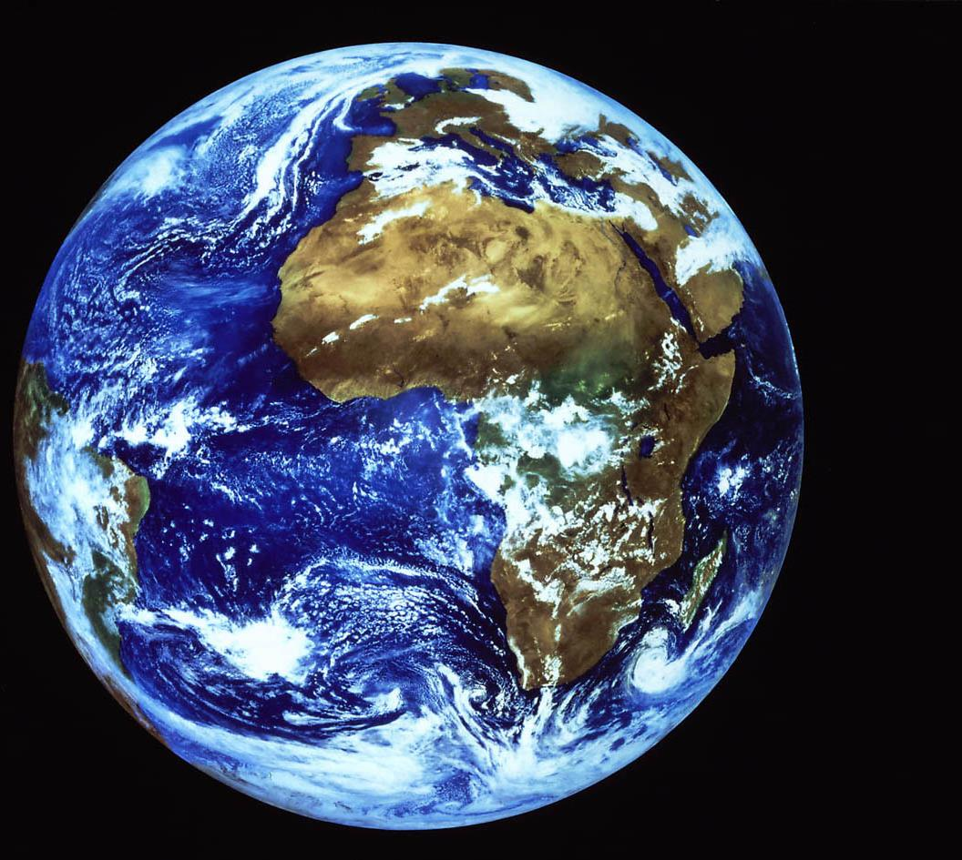
Sustainability
Environmental
Kerosene is a fossil fuel.
Reducing the use of the kerosene lamp saves up to an estimated 200 kg of CO₂ a year.
Notes:
And what about the planet?
Solar panels do not emit damaging fumes that pollute our planet – they are a clean, renewable source of energy.

Slide 20
UK Charity SolarAid set up SunnyMoney to eradicate the kerosene lamp from Africa by 2020.
SunnyMoney supports local people in rural off-grid communities to develop businesses to sell solar lights.

Slide 21
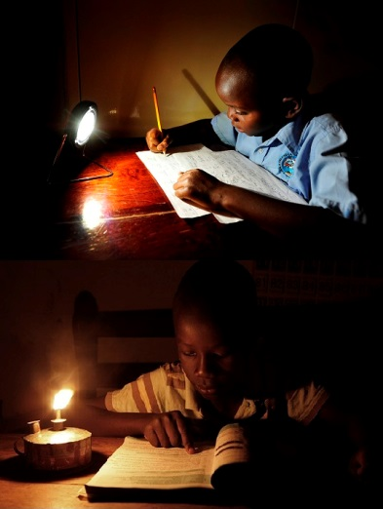
Solar lights provides clean safe affordable light reaching those who need it the most
SolarAid are tackling two of the world’s greatest challenges: Poverty and Climate Change
The dim light by kerosene lamps keep people in poverty, emitting toxic fumes, and costing 15%* of household income

