Slide 1
Is solar power part of the energy
solution in the UK?

Slide 2
UK energy headlines
UK Coal confirms Thoresby pit closure date
Gas imports from Russia's Gazprom giant to soar after new Centrica deal
Millions of Britons face winter power cuts
Solar energy 'could provide 4% of UK electricity by 2020'
Climate-smart cities could save the world $22tn, say economists
Hinkley Point nuclear plant delayed, says EDF
Travel chaos as power cut hits London
UK's coal plants to be phased out within 10 years
Notes:
Millions of Britons face winter power cuts http://www.express.co.uk/news/uk/435107/Millions-of-Britons-face-winter-power-cuts
Travel chaos as power cut hits London http://www.dailymail.co.uk/news/article-194118/Travel-chaos-power-cut-hits-London.html
Climate change: 2015 will be the hottest year on record 'by a mile', experts say http://www.independent.co.uk/environment/climate-change/climate-change-2015-will-be-the-hottest-year-on-record-by-a-mile-experts-say-10477138.html
Climate-smart cities could save the world $22tn, say economists http://www.theguardian.com/environment/2015/sep/08/climate-smart-cities-could-save-the-world-22tn-say-economists
Solar energy 'could provide 4% of UK electricity by 2020‘ http://www.bbc.co.uk/news/science-environment-32028809
Gas imports from Russia's Gazprom giant to soar after new Centrica deal http://www.independent.co.uk/news/business/news/gas-imports-from-russias-gazprom-giant-to-soar-after-new-centrica-deal-10248692.html
Hinkley Point nuclear plant delayed, says EDF http://www.bbc.co.uk/news/business-34149392
UK Coal confirms Thoresby pit closure date
http://www.itv.com/news/calendar/update/2015-06-19/latest-update-on-kellingley-and-thoresby-from-uk-coal/
UK's coal plants to be phased out within 10 years http://www.bbc.co.uk/news/business-34851718

Slide 3
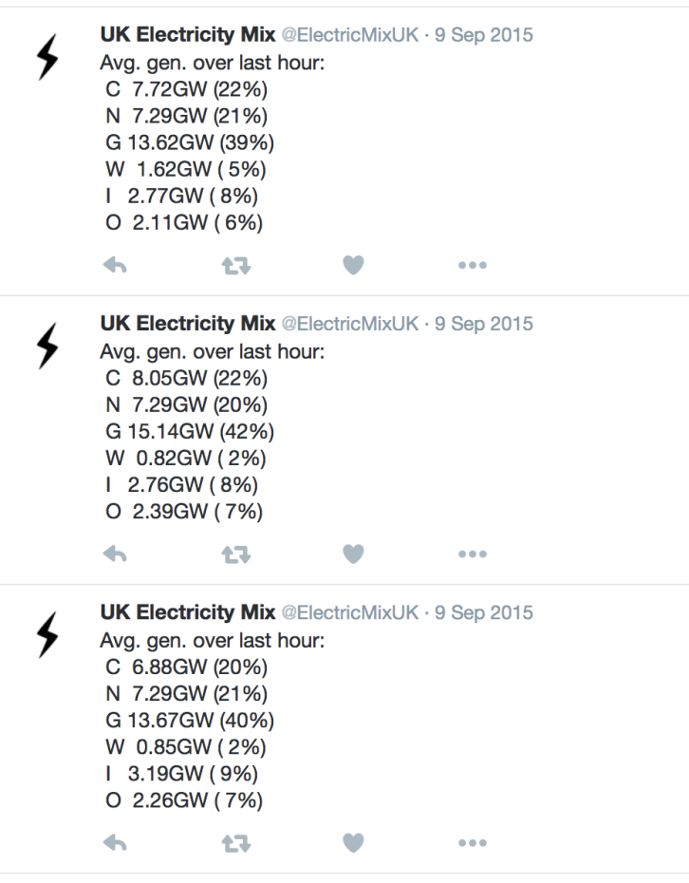
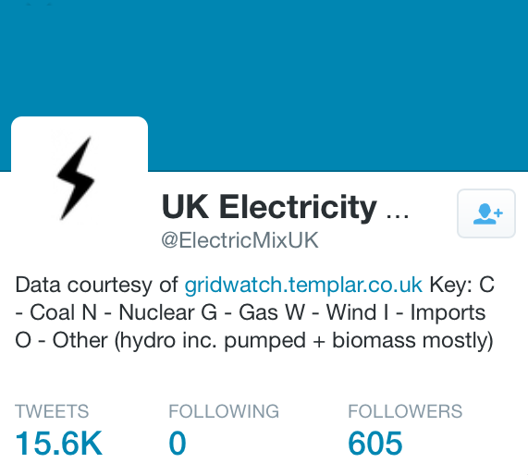
UK Electricity Mix
@ElectricMixUK Twitter feed shows energy resources used for electricity generation each hour in the UK.
This data is for 8.00 am, 10.00 am, and 11.00 am on Wednesday 9th September 2015.

Slide 4
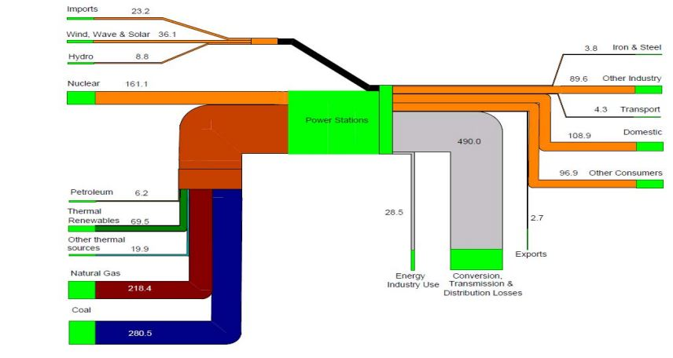
(UK) Electricity flow chart 2014 (TWh)
Wind 32 TWh
Solar 4.1 TWh
Wave and tidal 0.002 TWh
https://www.gov.uk/government/uploads/system/uploads/attachment_data/file/448356/DUKES_2015_Annex_H.pdf

Slide 5
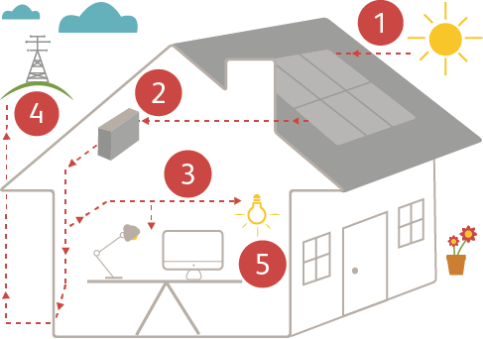
How do solar panels work?
Solar panels are an array of solar photovoltaic (PV) cells. The sun’s radiation hits these cells and produces a potential difference (voltage) across the cells, which drives a direct current (DC) through the circuit.
An electrical device called an inverter, converts the DC into alternating current (AC).
The AC produced is identical to the 230 V mains supply, and can directly power things like computers and lights.
Or the power produced can be exported back to the National Grid and to be redistributed around the country.
The system performance can be monitored.

Slide 6
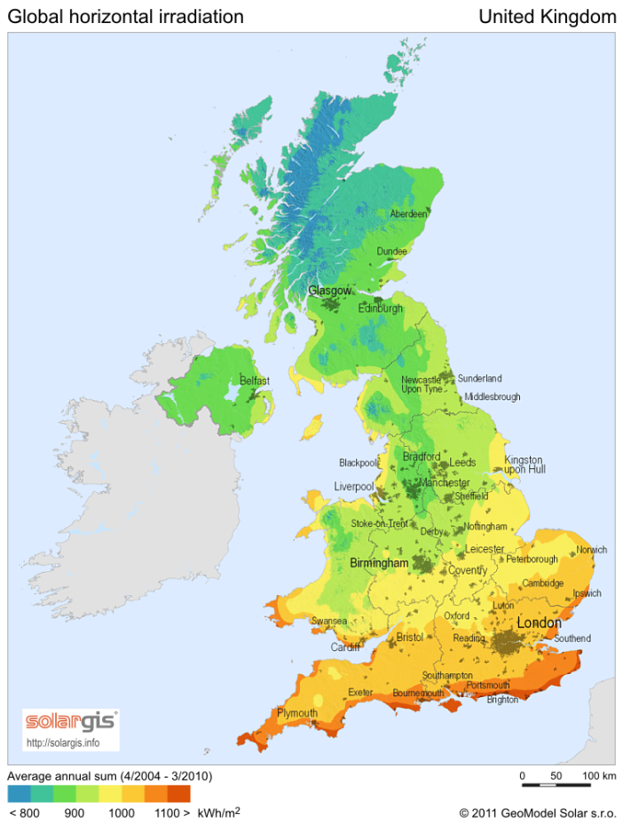
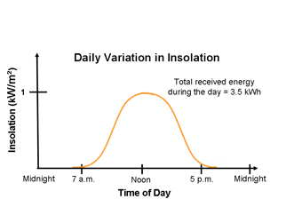
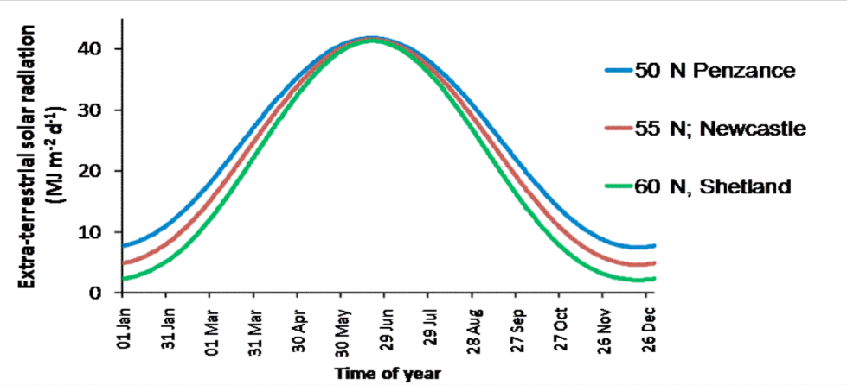
Solar Radiation in the UK
Monthly Variation in Insolation
Solar Irradiation MJ/m²/d
Notes:
What is Global Horizontal Irradiance?
The radiation reaching the earth's surface can be represented in a number of different ways. Global Horizontal Irradiance (GHI) is the total amount of shortwave radiation received from above by a surface horizontal to the ground. This value is of particular interest to photovoltaic installations and includes both Direct Normal Irradiance (DNI) and Diffuse Horizontal Irradiance (DIF).

Slide 7
How much energy can be generated by the solar panels on a house roof?
Peak output from a solar panel is about 140 W/m².
What do the units W/m² tell us?
The average output of a solar panel in the UK is closer to 16 W/m² over a year.
Why is the average output of a solar panel on the roof of a house so much less than the peak output?
Sheffield

Slide 8
How much energy can be generated from the solar panels on a house roof?
The average output of the solar panels is about 16 W/m²
The area of the panels on one house is about 14 m²
Calculate the average output power of the solar panels.
Calculate the energy the panels could generate over a year. Give your answer in kWh.
power = 16 W/m² x 14 m² = 224 W
energy = 0.22 kW x 12 h/day x 365 days
energy = 950 kWh (2sf)
Sunstation solar panels

Slide 9
How much energy does a family use in a year?

Slide 10
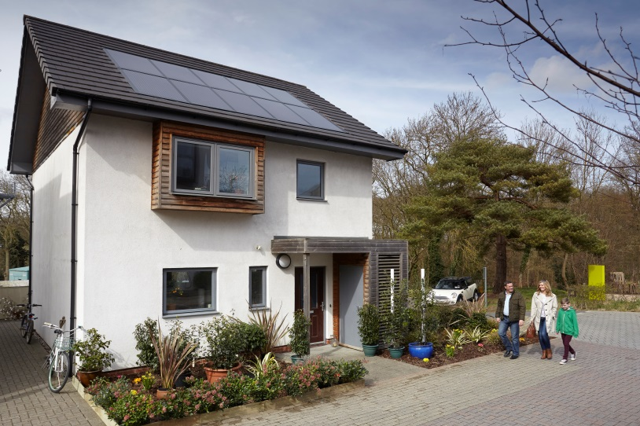
What factors should a family consider when deciding whether to install solar panels?
What is involved in installing solar panels?
How much will we be paid for energy that goes into the National Grid?
How much will it cost to install the panels?
Does it make any difference if we use most of our energy at night?
How many units of electricity will it produce in a year?
How many units of electricity do we use in a year?
How much will it reduce our electricity bills?
How long will the solar panels last?

Slide 11
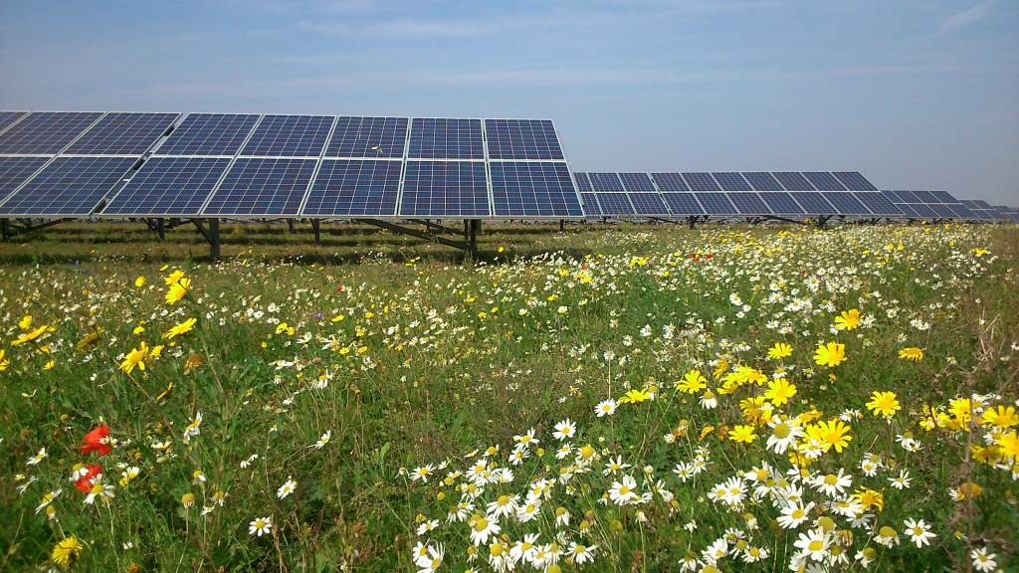
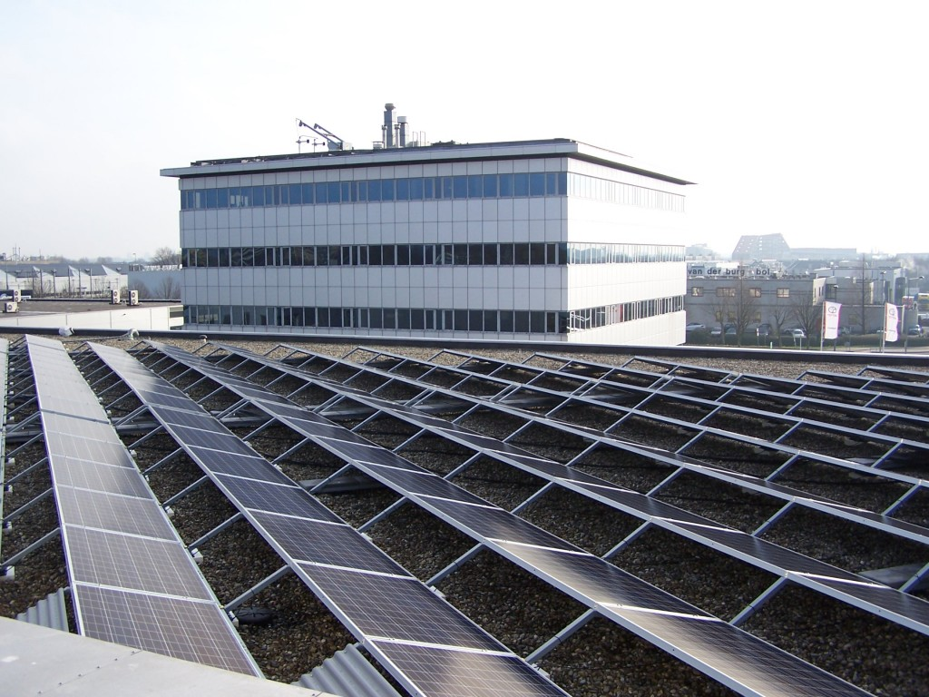
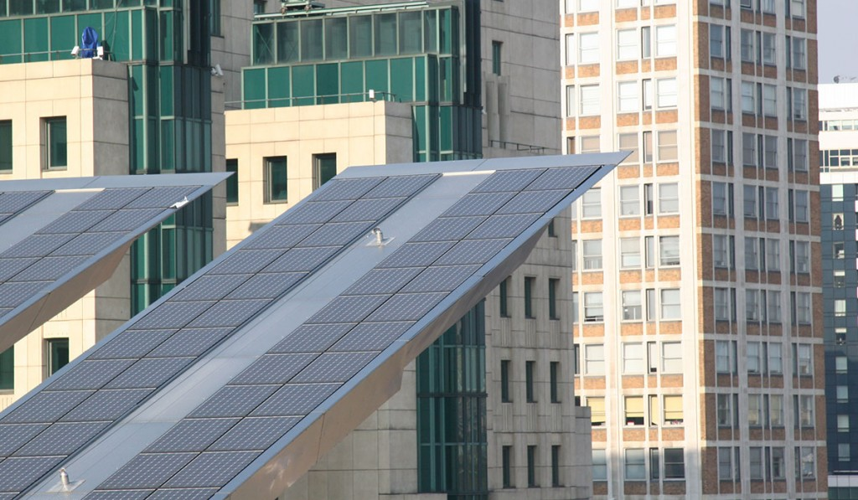
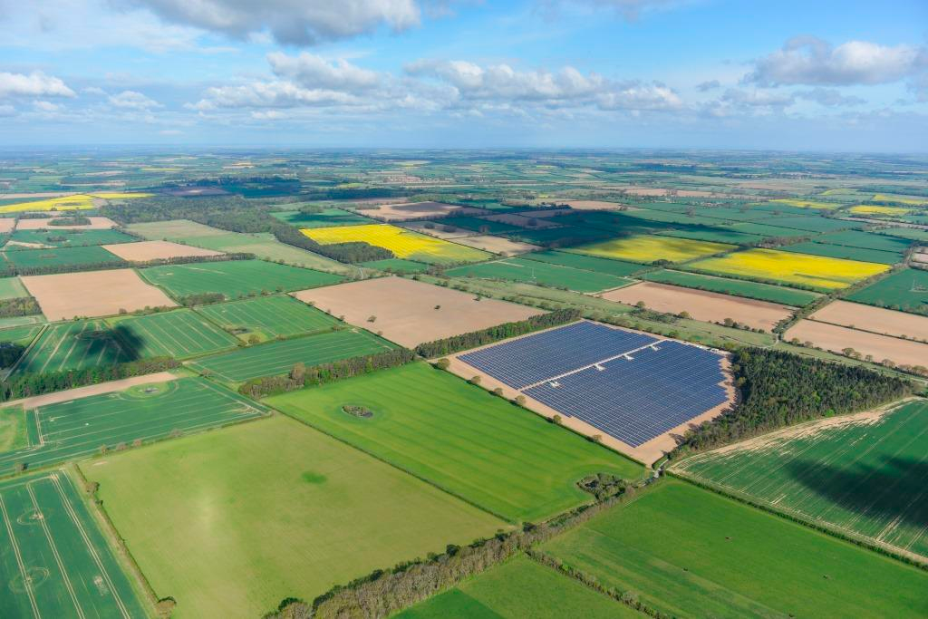
Where else can solar panels be sited?
Notes:
http://www.solarcentury.com/uk/wp-content/uploads/sites/2/2014/07/Gruber-DSC_0231-web.jpg
http://www.solarcentury.com/uk/wp-content/uploads/sites/2/2014/07/100_6628-1024x768.jpg
http://www.solarcentury.com/uk/wp-content/uploads/sites/2/2014/07/Vauxhall-Cross-Bus-Station01-1024x597.jpg
http://www.solarcentury.com/uk/wp-content/uploads/sites/2/2013/05/Blackfriars-solar-is-half-way-1024x682.jpg
http://www.solarcentury.com/uk/wp-content/uploads/sites/2/2013/11/DSC0311-sm.jpghttp://www.solarcentury.com/uk/wp-content/uploads/sites/2/2014/12/solar-panels-wildflowers.jpg

Slide 12
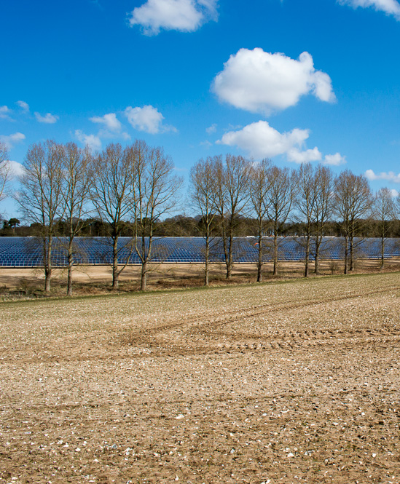
Solar farms – weighing up the arguments
What are the effects of solar farms on habitat and biodiversity?
What is the effect of a solar farm on the landscape?
Is a solar farm the best use of agricultural land?
What are the benefits of using land for solar farms?
Should solar farms be subsidised by government?

Slide 13
How much energy from solar farms?
Tittleshall, Norfolk
16 hectare (ha) (1.6 x 10⁵ m²)
32,000 solar panels
Size of the system 7.9 MWp
7,890 MWh per year
UK used about 300 TWh in 2014
Solar energy 'could provide 4% of UK electricity by 2020'
How many similar solar farms would be needed to generate 4% of 300 TWh?

Slide 14
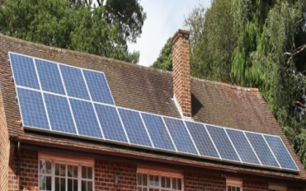
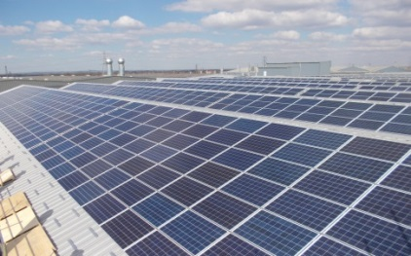
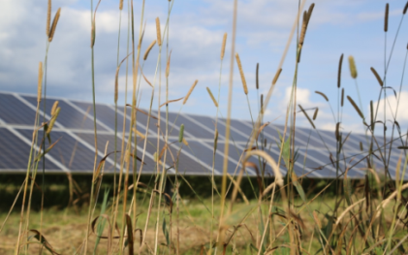
A solar energy mix – targets for 2020
2 million solar homes
(670,000 solar homes in 2015)
2 million solar homes
(670,000 solar homes in 2015)
17,000 commercial rooftops
(1200 installations, 50-250kWp)
(70 larger-scale over 250kWp)
*August 2015
17 TWh
1800 solar farms
(432 in 2015)

Slide 15
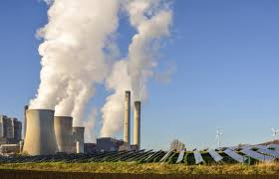
Energy in the UK
Activity
Name three sources of non-renewable energy used to generate electricity in the UK
Name three sources of renewable energy used to generate electricity in the UK
Give one argument for and one argument against increasing the use of each type of renewable energy
Explain the link between solar energy and carbon emissions
Non-renewable Vs renewable energy

