Slide 1
Appin Wind Farm www.appinwindfarm.co.uk
March 2022

Slide 2
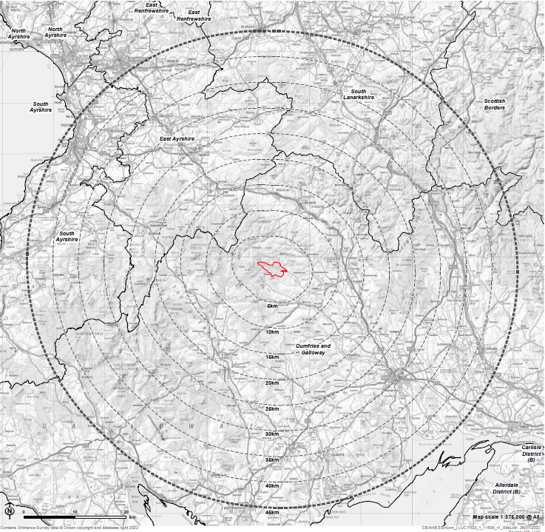
About the Site Site Location & Potential
Update Maps from scoping
Project at Scoping stage. Scoping live 24 March 22.
Site boundary approx. 12.5km to west of Thornhill and 7km north-west of the village of Moniaive.
Proposing a maximum of up to 25 wind turbines.
Considering turbines up to 230 metres to blade tip height.
Project will have an installed capacity greater than 50 MW.
Project size to be determined as studies are completed, consultation feedback received, and future design milestones reached.

Slide 3
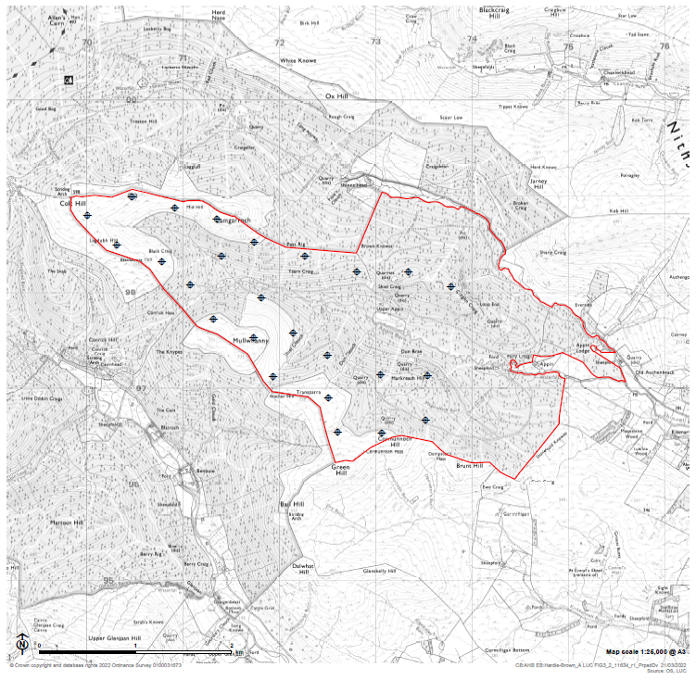
About the Site Site Location & Potential
The project team are continuing to refine the design of the wind farm based on findings of the ongoing baseline studies.
The proposed scoping layout for 25 turbines is shown on the right.
Turbine numbers, tip heights and locations are still to be fixed.
The layout will be finalised following completion of studies and community consultation feedback.

Slide 4
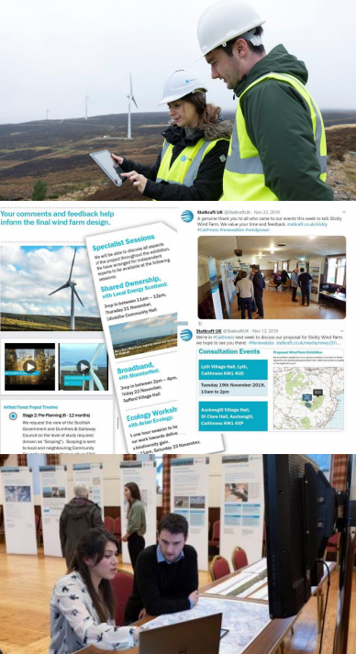
Next Steps
Ongoing studies to learn more about the site.
Project website launched in March 22.
We are committed to engaging with the community throughout the project.
We look forward to hearing your suggestions on how to let as many local residents as possible know about the project.
If consented, a community benefit fund will be available for this project of £5k per MW of installed capacity.
And, if interest from within the community, we can explore a community investment opportunity.
We will continue to follow Scottish Government advice in relation to Covid-19.

Slide 5
The Appin Project Team
Jess Antas jess.antas@statkraft.com
Lloyd Godwin Lloyd.godwin@statkraft.com
Ruth Semple ruth.semple@statkraft.com
Doug Wilson
Doug@smithyhouseassociates.co.uk
www.appinwindfarm.co.uk
statkraft.co.uk

